Slide 1
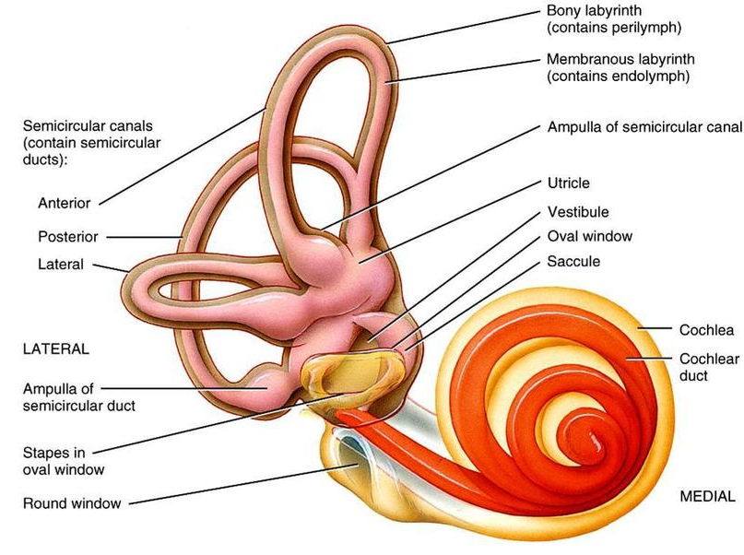
Inner ear
Equilibrium
Vestibular apparatus
sound
Cochlea

Slide 2
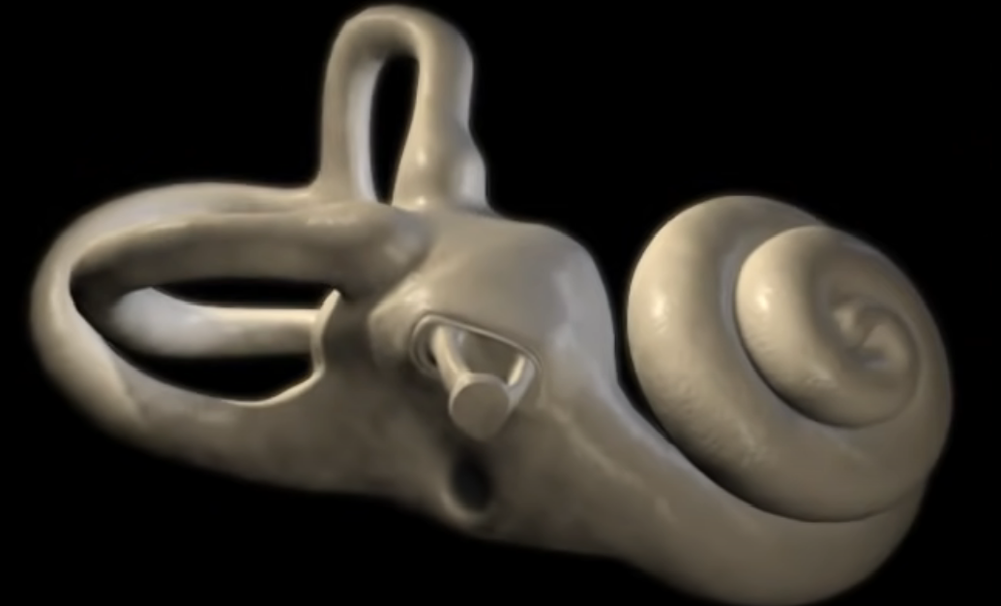
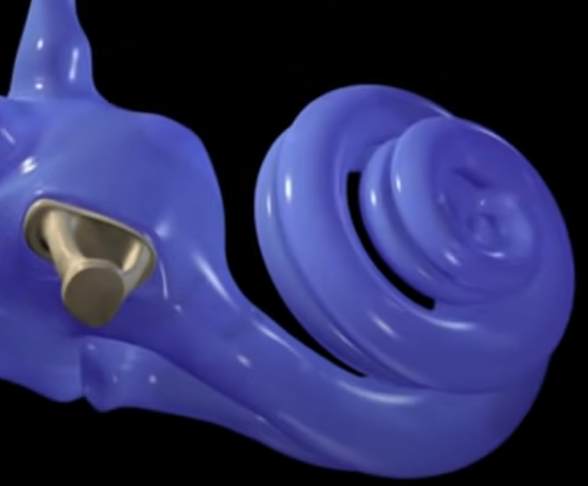
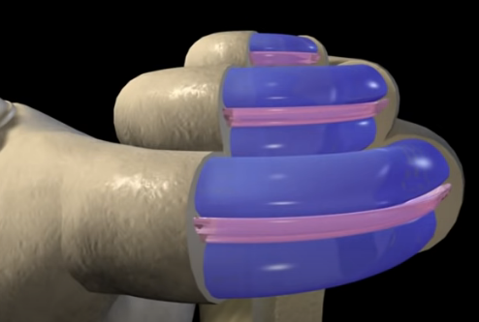
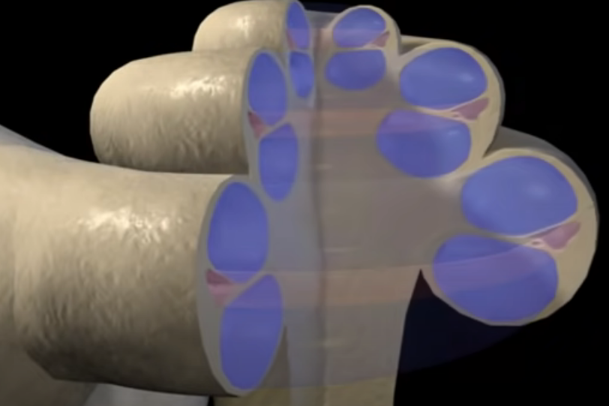
Auditory Transduction
Looking from bottom
Scala Vestibuli
Cochlear Duct
Scala Tympani

Slide 3
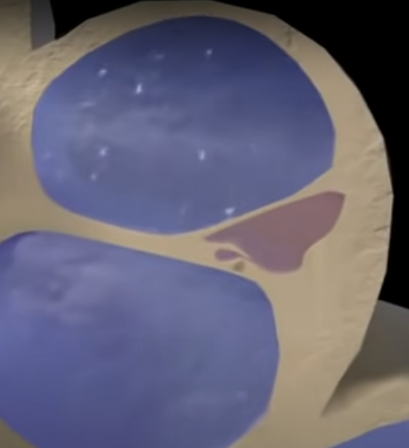
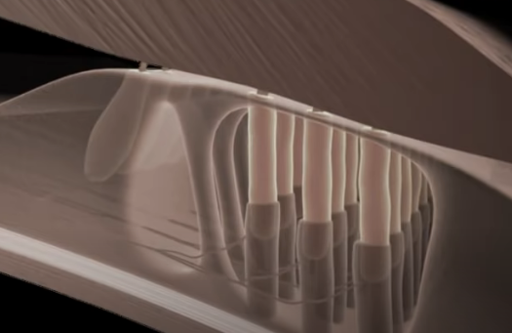
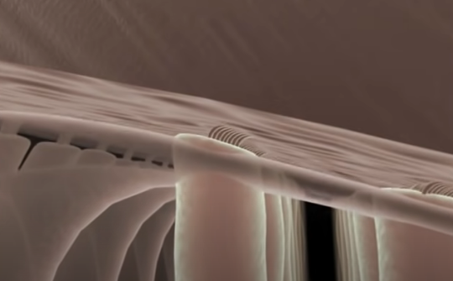
Tectorial membrane
Perilymph
Basilar membrane
Endolymph
Organ of Corti
Perilymph

Slide 4
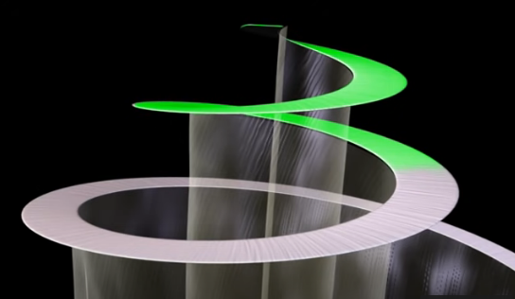
Lower frequency
Entire Basilar membrane does not vibrate simultaneously - - Tonotopic organisation

Slide 5
Physiology of Equilibrium
There are two types of equilibrium or balance:
Static equilibrium
Refers to the maintenance of the position of the body (mainly the head) relative to the force of gravity, including tilting of head and linear acceleration.
Dynamic equilibrium
Refers to the maintenance of the position of the body (mainly the head) in response to sudden movements, such as rotational acceleration or deceleration.

Slide 6
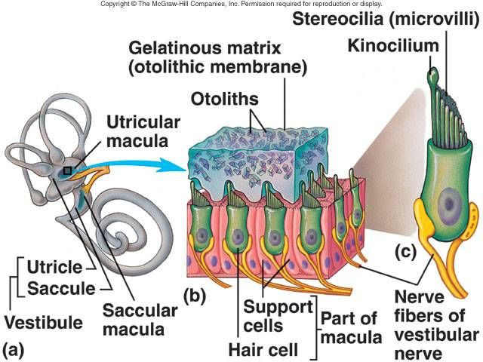
Maculae

Slide 7
Maculae: salient features
The walls of both the utricle and the saccule contain a small, thickened region called a macula.
The two maculae (perpendicular to each other) are the receptors for static equilibrium.
They provide sensory information on the position of the head in space and thus are essential for maintaining appropriate posture and balance.
They also can sense linear acceleration or deceleration.
The macula contains two types of cells: Hair cells and Support cells.
Each hair cell contains 40-80 stereocilia plus one kinocilium, collectively called hair bundle.
Support cells secrete the thick, gelatinous, G-protein layer, called the otolithic membrane, that rests on the hair cells.
At the top of the otolithic membrane floats calcium carbonate crystals called otoliths.

Slide 8
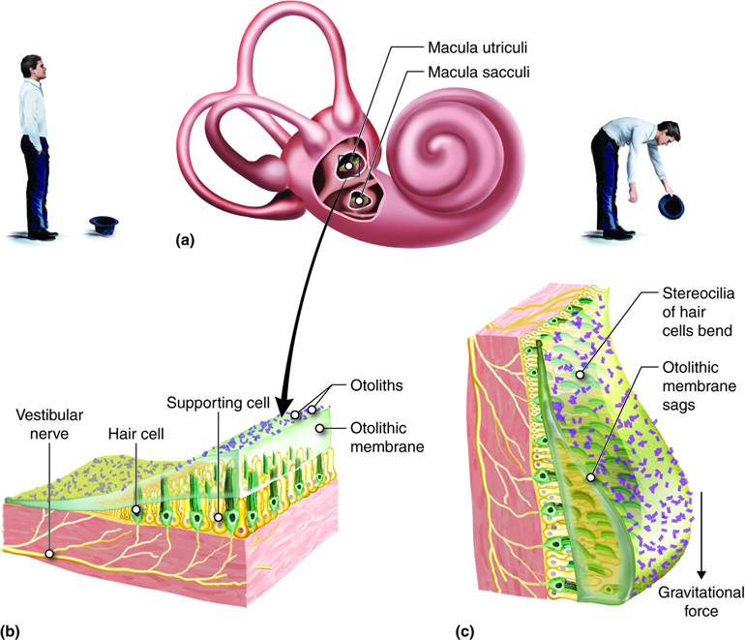
Macula: its role in static equilibrium
If the head is tilted forward, the otolithic membrane (along with the otoliths) is pulled by gravity.
It slides ‘downhill’ over the hair cells, in the direction of the tilt, bending the hair bundles.
This causes the hair cells depolarize or repolarize, facilitating release of neurotransmitter at faster or slower rate.
The hair cells synapse with first order sensory neurons in the vestibulocochlear nerve.
The also synapse with motor neurons that regulate sensitivity of the hair cells.

Slide 9
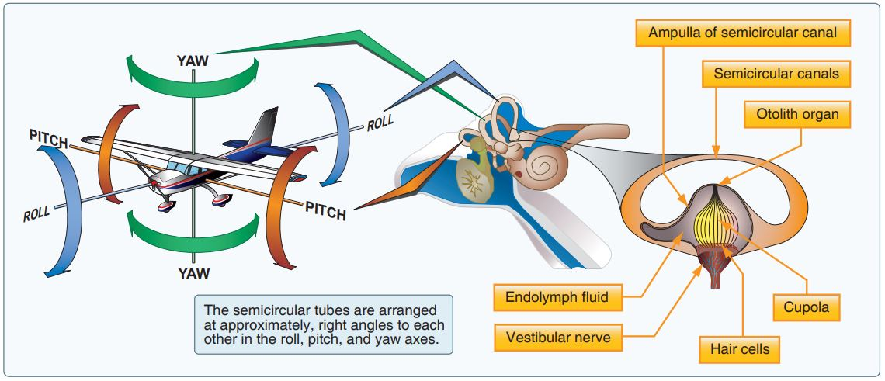
The Three Semicircular Ducts

Slide 10
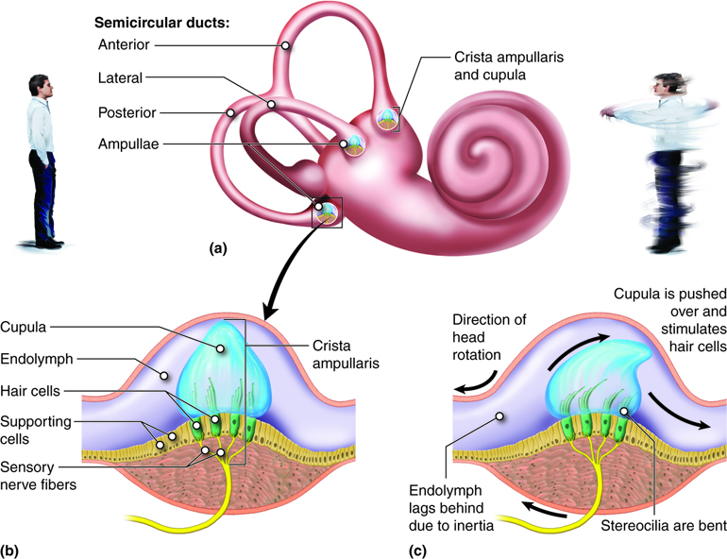
Semicircular ducts: role in dynamic equilibrium
The three ducts function in dynamic equilibrium.
The ducts lie at right angles to one another in three mutually perpendicular plane.
This positioning permits detection of rotational acceleration or deceleration.
In the ampulla, there is a small elevation called crista.
Covering the crista is a mass of gelatinous material called the cupula.
If the head is rotated, cupula is pushed over thereby stimulating the hair cells.

Slide 11
Quick test on functionality:
Auricle ?
Eardrum ?
Auditory ossicles ?
Eustachian tube ?
Cochlea ?
Vestibular apparatus:
- Utricle and Saccule ?
- Semicircular ducts ?

